Slide 1
MBAN 6400 S2 – MV Regression and Analysis of Variance (statistical and partial control) Hemant Sangwan

Slide 2
Agenda – MV Regression and Analysis of Variance
Variance Partitioning in Data and Modeling
Methods of Variance Partitioning (or statistical control)
Key concepts in Variance Partitioning (or statistical control)
Partial and Semi-Partial correlation
Confounding and Suppressor variables
Mediation and Moderation effects
Linear and Multivariate Regression
Univariate and Multivariate Tests

Slide 3
Variance Partitioning in Data

Slide 4
Multivariate Analytics
Analyzing two or more variables simultaneously to...
Discover patterns of relationships among many variables, including hidden and barely visible patterns
Measure relative importance of a set of variables in explaining or predicting important outcome(s)
Make predictions of important outcomes
At high level, multivariate/analytics is about identifying patterns and explaining variations in data by using specific technique(s)
Example: Where the total variance is coming from?
Total variance is partitioned or decomposed into two components
ESS (error sum of square): Fitted values deviating from actual values
RSS (regresion sum of square): Variability explained by regression
TSS=ESS + RSS. Why?
TSS=Var (y) =⅀(y- ȳ)² = ⅀(y- ŷ+ŷ-ȳ)² = ⅀(y- ŷ)² + ⅀(ŷ-ȳ)²= ESS + RSS
TSS is fixed. So what exactly the regression algorithm is doing?

Slide 5
Sources of Variance
If two variables (x1,x2) are correlated, i.e., correlation (x1,x2) is not zero, then what are possible relationships which could exist between them?
x1 causes x2 x1 →x2
x2 causes x1 x2 →x1
x1 causes x2, x2 causes x1 (x1 →x2, x2 →x1)
x1 causes w, w causes x2 x1→ w→x2
… and many more
A key question –Which of the above relationships is true and how do you find put about it?
Suppose x1 →x2 is true, then what is the unique contribution of x1 in explaining x2? In other words, there could be other variables (w1, w2,…wn) which could cause x2. So what is the strength of relationship (x1,x2) relative to [x2, and (w1, w2,…wn)]

Slide 6
Variance Partitioning to identify sources of variance
Total variance is partitioned or decomposed into two or more components
To identify unique contribution of a variable in explaining variance
To study complex relationships
To detect validity of relationship in “if A then B”, e.g., “if discount then more sales”
Is it the discount which is related to sales and not some other variable, e.g., distance to store, store hours, etc.?
If other variables are also related to sales, then what is the importance of discount in influencing sales?
Y | X1 | X2
100 | 40 | 40
103 | 62 | 62
155 | 74 | 74
85 | 55 | 55
70 | 25 | 25
190 | 95 | 95
90 | 110 | 110
Does x1 explain variation in y MORE than x2?

Slide 7
Statistical Control – A key terminology in variance partitioning and modeling
Control=control of variance
Statistical and analytical methods which can
identify and isolate the variance in a dependent variable caused by one or more independent
nullify the “undesirable” variance in a dependent variable caused by one or more independent variables
Multiple linear regression is an example of “controlling” for independent variables

Slide 8
Different methods of statistical control (or explaining variance )
ANOVA: Variance attributes to within and between groups
Linear Regression: Variance attributed uniquely to each independent variable (only 1 DV y)
Multivariate Regression: Variance attributed uniquely to each independent variable (> 1 DVs y)
Clustering: Variance within the cluster vs Variance between clusters
Factor Analysis: Variance captured and explained by lower dimension data
And many more

Slide 9
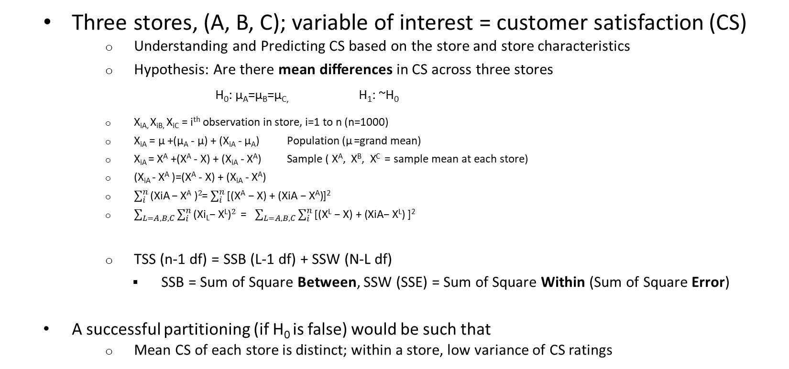
Example – ANOVA (where the variance is coming from?)
Three stores, (A, B, C); variable of interest = customer satisfaction (CS)
Understanding and Predicting CS based on the store and store characteristics
Hypothesis: Are there mean differences in CS across three stores
H₀: µ_{A}=µ_{B}=µ_{C,} H₁: ~H₀
X_{iA,} X_{iB,} X_{iC} = i^{th} observation in store, i=1 to n (n=1000)
X_{iA} = µ +(µ_{A} - µ) + (X_{iA} - µ_{A}) Population (µ =grand mean)
X_{iA} = X^{A} +(X^{A} - X) + (X_{iA} - X^{A}) Sample ( X^{A}, X^{B}, X^{C} = sample mean at each store)
(X_{iA} - X^{A} )=(X^{A} - X) + (X_{iA} - X^{A})
$\sum_{i}^{n}{\text{(}\text{XiA} \text{− }\text{X}\text{A}\text{ )}2}$= $\sum_{i}^{n}{\text{[}\text{(}\text{X}\text{A}\text{ − }\text{X}\text{) + (}\text{XiA}\text{ − }\text{X}\text{A}\text{)}}$]²
$\sum_{L=A,B,C}{\sum_{i}^{n}{\text{(}\text{Xi}\text{L}\text{− }\text{X}\text{L}\text{)}2}}$ = $\sum_{L=A,B,C}{\sum_{i}^{n}{\text{[}\text{(}\text{X}\text{L}\text{ − }\text{X}\text{) + (}\text{XiA}\text{− }\text{X}\text{L}\text{)}}\text{]}\text{2}}$
TSS (n-1 df) = SSB (L-1 df) + SSW (N-L df)
SSB = Sum of Square Between, SSW (SSE) = Sum of Square Within (Sum of Square Error)
A successful partitioning (if H₀ is false) would be such that
Mean CS of each store is distinct; within a store, low variance of CS ratings

Slide 10
Analysis of Variance (ANOVA and MANOVA)
No of Population* | Variables | Hypothesis | Technique
L=1 (e.g., Canadians) | P=1 (e.g., height) | H₀: µ=µ₀ H₁: µ≠µ₀ | T-test
L=1 (e.g., Canadians) | P=2 (e.g., height, weight) | H₀: µ=µ₀ H₁: µ≠µ₀ µ= vector (2x1) | Hoteling T²
L=2 (e.g., Canadians, US) | P=1 (e.g., height) | H₀: µ_{Can}=µ_{US} H₁: µ_{Can}≠µ_{US} | T-test
L=2 (e.g., Canadians, US) | P=2 (e.g., height, weight) | H₀: µ_{Can}=µ_{US} H₁: µ_{Can}≠µ_{US} µ_{Can}, µ_{US} each vector (2x1) | Hoteling T²
L ≥ 3 (e.g., Canadians, US, Mexico) | P=1 (e.g., height) | H₀: µ_{Can}=µ_{US}=µ_{Mex} H₁: ~H₀ | ANOVA
L ≥ 3 (e.g., Canadians, US, Mexico) | P=2 (e.g., height, weight) | H₀: µ_{Can}=µ_{US}=µ_{Mex} H₁: ~H₀ µ_{Can}, µ_{US,} µ_{Mex} each vector (2x1) | MANOVA
Assumption: Independent variables, i.e., country etc., are discrete (or nominal categorical)
*Universe of analysis unit, bounded by geography, time, or other dimensions (e.g., behavioural characteristics)

Slide 11
Examples – Statistical Control and Variance Partitioning
People who have university degree, drive expensive cars, live in “expensive” neighbourhood have higher life expectancy than those who do not have possess such characteristics
Higher income → better access to health and healthy lifestyle → higher life expectancy
University degree or driving expensive cars have no relation with life expectancy
Coffee – good or bad for you?
Is it coffee or personality, climate, or occupation responsible for heart?
High correlations between variables which are affected by age/time, if age/time is not controlled for Source: New Heart Absolves Coffee, Jane E Brody,1973. Retrieved from https://www.nytimes.com/1973/10/29/archives/newheart-study-absolves-coffeeee-contradicts-earlier-findings-of.html
Spurious correlations: when correlation between two variables, X, Y is SOLELY due to their association with a third variable, Z

Slide 12
Partial correlations
Partial correlation: correlation between two variables from which the effects of the rest of the other variable(s) have been removed
Do you expect a positive or negative correlation between (height, intelligence)?
What happens to the correlation if you remove the effect of age from each variable? i.e., correlation (height - age, intelligence - age)
Partial correlation is represented as r₁₂.₃ → correlations of (1,2), i.e., correlation after 3 has been controlled or partialled out
Example: Suppose we want to study relationship between (y,x1) in its purest form, i.e., (y,x1) after effect of x2 has been partialled out or unique contribution of x1 on y
y=sales, x1=price, x2=store loyalty
Model 1: y= 𝛽₀ + 𝛽₁ x1+𝛽₂ x2 + error
Model 2:
Step 1: Regress y on x2, i.e., y= a₀ + b₀ x2+ e₀ or e₀ =y- a₀ - b₀ x2 (part of y which does not depend on x2)
Step 2: Regress x1 on x2, i.e., x1= a₁ + b₁ x2+ e₁ or e₁ =x1-a₁ - b₁ x2 (part of x1 which does not depend on x2)
Step 3: Regress e₀ on e₁ , i.e., e₀ = + 𝛽 e₁ + error
Do you think 𝛽₁ = 𝛽 ? Why or why not?

Slide 13
Partial correlations – zero, first, and higher order
Zero order correlation is simple correlation between two variables (y,x1)
First, second, third, nth order partial correlations are when (1, 2, 3, …n variables ) are partialled out from (y,x1)
𝛽₁ is the first order partial correlation between (y, x1) in y= 𝛽₀ + 𝛽₁ x1+𝛽₂ x2 + error
𝛽₁ is the second order partial correlation between (y, x1) in y= 𝛽₀ + 𝛽₁ x1+𝛽₂ x2 + 𝛽₃ x3 + error
𝛽₁ is nth order partial correlation between (y, x1) in y= 𝛽₀ + 𝛽₁ x1+𝛽₂ x2 + 𝛽₃ x3 + …+ 𝛽_{n+1} x_{n+1} + error
Nth order partial correlation is when n variables are partialled out from (y,x1)
Linear regression coefficients are also called partial correlation coefficients!

Slide 14
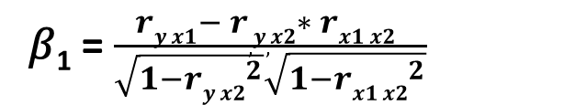
Partial correlations – without linear regression
We do not need regression to calculate partial correlation between two variables
Show the formula below is same as the regression coefficient with two independent variables
y= 𝛽₀ + 𝛽₁ x1+𝛽₂ x2 + error
𝛽₁ = $\frac{ry x1− r,y,x2∗ rx1 x2 }{\sqrt{1−{ry x2}^{2}}\sqrt{1−{rx1 x2}^{2}}}$

Slide 15
Activity – Partial correlation
Suppose the following relationships expressed in correlation forms are given to you
y=revenue generated by management consulting industry in GTA
x1=# graduates from MBAN programs at Schulich
x2=income growth in GTA economy
correlation (y,x1)=0.65, correlation (y,x2)=0.90, correlation (x1,x2)=0.70
Questions
What would be correlation (y,x1) after partialling out x2 from both variables?
How do you interpret zero-order correlation, i.e., original correlation (y, x1)=0.65?

Slide 16
Partial correlations – Limitations
Partialling out variables (or adding variables to linear regression equation) without conceptual knowledge and theoretical considerations will most likely lead to misinterpretation/meaningless results
Excessive use of higher order, i.e., adding IVs to regression model, partial correlations is an indication of lack of theoretical model / desperations to fit the model
Example
We want to study relationship between (y, x1)? Should we partial out x2 from both y and x1?
y=Academic achievement, x1=Student’s intelligence on analytical abilities, x2=Student’s intelligence on creative abilities

Slide 17
Semi-partial correlations
Semi-Partial correlation: When a variable (x2) is partialled out from EITHER y OR x1 but NOT from both.
Semi-Partial correlation is represented as r₁₍₂.₃₎→ semipartial correlation when variable 3 is partial pout from ONLY 2 (not from 1)
Example: The school wants to understand relationship between (y, x1). Can we use partial correlation? What will happen when x2 is partialled from both (y and x1)
y=GPA, x1=performance in entrance exam, x2=student’s intelligence
Once x2=student’s intelligence is removed, it is highly likely that correlation (y, x1) = ~0
Solution: remove x2 only from x1, i.e., measure effect of ONLY performance in entrance test on y

Slide 18
Partial and Semi-partial correlations – Visualization
When independent variables (IVs) are orthogonal, i.e., correlation(x1,x2)=0, then each variable’s unique contribution is equal to its squared correlation with dependent variable (DV)
Contribution of
x1=[a] / ([a]+[b]+[c])
x2=[b] / ([a]+[b]+[c])
When independent variables (IVs) are NOT orthogonal, i.e., correlation(x1,x2)≠0
Contribution of x1
Overall contribution (y, x1)=([a] +[c])/ ([a]+[b]+[c]+[d])
Partial correlation (y,x1)=[a] / ([a]+[d])
Semi-partial correlation (y,x1)=[a] / ([a]+[b]+[c]+[d])
[c]
Y =
x₁
[a]
x₂
[b]
[d]
Y =
x₁
[a]
x₂
[c]
[b]

Slide 19
Semi-partial correlations
Semi-Partial correlation: When a variable (x2) is partialled out from EITHER y OR x1 but NOT from both
Semi-Partial correlation is represented as r₁₍₂.₃₎→ semipartial correlation when variable 3 is partial pout from ONLY 2 (not from 1)
Example: The school wants to understand relationship between (y, x1). Can we use partial correlation? What will happen when x2 is partialled from both (y and x1)
y=GPA, x1=performance in entrance exam, x2=student’s intelligence
Once x2=student’s intelligence is removed, it is highly likely that correlation (y, x1) = ~0
Solution: remove x2 only from x1, i.e., measure effect of ONLY performance in entrance test on y

Slide 20
Other important concepts in Variance Partitioning
Confounding: When true impact of variable is not measured due to presence of other variable
Suppose Toblerone chocolate comes ONLY in (1 colour, 1 shape). If a customer buys it, we cannot estimate separate effects of colour and shape on the choice
y=a₁+b₁ x₁+ c₁x₂ (x₂ is confounding the impact of x₁)
Y= knowledge in analytics, x1=scores on exam in analytics, x2=speed of reading
Suppression: When true impact of a variable is suppressed in absence of another variable...opposite to confounding! Example: With three variables, y, x1, x2
x2 is suppressor (or x1 is suppressed) if
correlation (y,x2)=0, i.e., y=a₀+b₂ x₂ → b₂ =0
correlation (x1,x2) ≠ 0
And
y=a₁+b₁ x₁
y=a₂+b’₁ x₁+ c₁x₂ y → b’₁ ˃ b₁ → i.e., adding x2 to the equation improves the impact of x1 on y (even though x2 is uncorrelated with y)

Slide 21
Mediation
Mediation: Effect of an independent variable x1 on y is transmitted both directly and indirectly
Direct impact: x1→ y
Indirect impact: x1→ m1→ y (m1 is called mediation variable)
Complete mediation implies x1 cannot impact y in absence of m1
Complete mediation⇒ c=0, Direct effect: c, Indirect effect: a x b
Mediation explains how or why there is a relationship between two variables. Mediation is a potential mechanism by which x1 impacts y
a
m1= Healthy choices
b
x1=Salary
y=Overall health
c

Slide 22
Moderation
Moderation explains the strength of the relationship between y and x1
Moderation specifies when a relationship will hold stronger or weaker
The effect of salary → healthy choice→ overall health is stronger for older people then age is a moderating variable, i.e., c2+ a2 * b2 > c1+ a1 * b1
Age 35 and younger
Age >36
a1
m1= Healthy choices
b1
a2
m1= Healthy choices
b2
x1=Salary
y=Overall health
x1=Salary
y=Overall health
c1
c2

Slide 23
Activity – Examples
Identify and list 2-3 examples/applications of (partial, semi-partial correlations, confounding and suppressor, and mediating and moderating effects)

Slide 24
Multiple Linear Regression (Supervised ML)

Slide 25
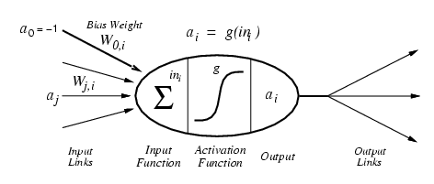
Machine Learning - Definition
"Machine learning is a field of computer science that gives computers the ability to learn [from data] without being explicitly programmed." Wikipedia

Slide 26
Machine learning - Supervised and Unsupervised
Supervised learning: The computer is “taught” with examples of desired inputs and outputs and goal is to learn from “input-output” relationships. Correct output known for each training example, i.e., data are labeled and computer learns to predict output for given inputs
Classification: 1-of-N output, i.e., categorical (speech recognition, object recognition, medical diagnosis)
Estimation/Prediction/Regression: real-valued output, i.e., continuous (predicting market share, prices, customer rating)
Unsupervised learning: The computer is “left on its own” to find structure in the data and learn the relationships between various inputs. It create an internal representation of the input, capturing regularities/structure/patterns in data, i.e., unlabeled data
Clusters; extract features (grouping customers)

Slide 27
Supervised Machine learning – Linear Regression
Francis Galton (1880s) observed the following patterns in the data analysis
Tall parents likely have tall children
Short parents likely have short children
But height of children of unusually tall or unusually short parents tend to move to the average height of the population
Law of universal regression: observations tend to move around population mean, i.e., regression towards mean
Important theoretical result of central limit theorem (CLT) is based on regression towards mean

Slide 28
Key questions Linear Regression can help answer
How average height of sons change with father’s height?
Can we predict average height of sons knowing height of fathers
Note: the focus is on “average” height, not on specific height of an individual

Slide 29
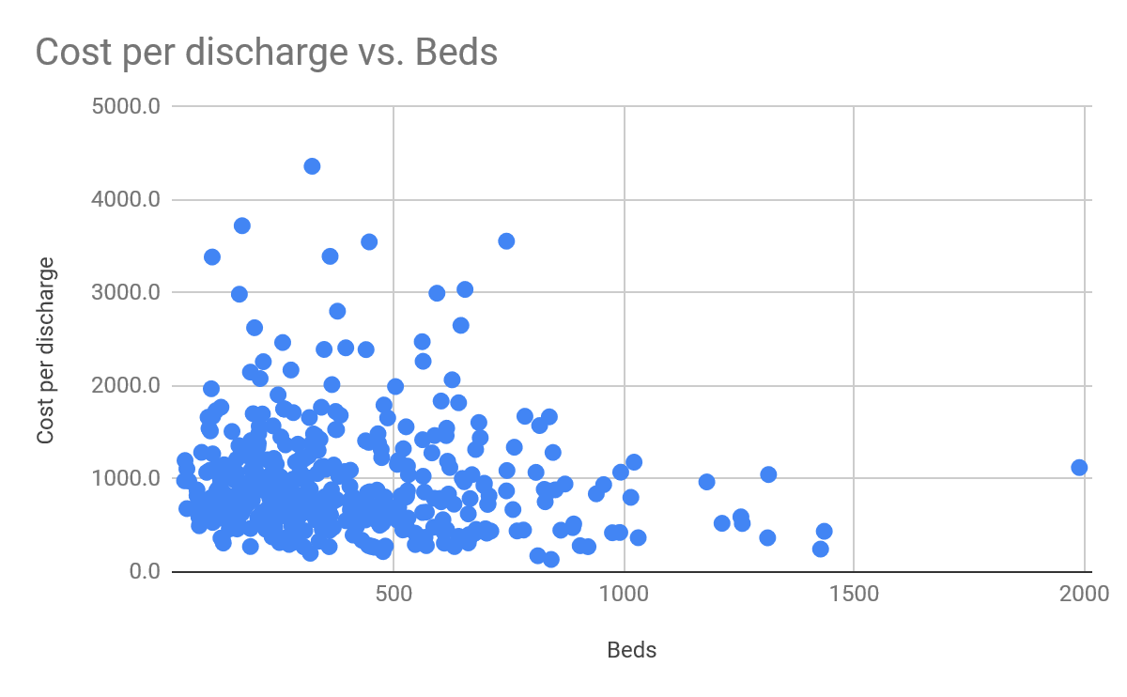

Linear Regression - Example
Corresponding to any value of beds (e.g., 500, 1000), there is a range of cost per discharge
However, average cost per discharge decreases as # beds increases
Can we predict average cost per discharge for a given value of # beds?

Slide 30
Regression vs Causation
Regression deals with dependence of 1 variable (cost per discharge) on other variables (hospital size, # beds, etc.). It does not imply causation
There is NO statistical/analytical reason to assume # beds does not depend on cost per discharge. In other words, in “regression world”, we could equally show dependence of # beds on cost per discharge
The reason we treat cost per discharge as a dependent variable (DV) is due to non-statistical reasons (common sense, theory)
“A strong statistical / analytical relationship can never establish causation: our ideas of causation must come from outside statistics, ultimately from theory or other” Kendall and Stuart: The Advanced Theory of Statistics

Slide 31
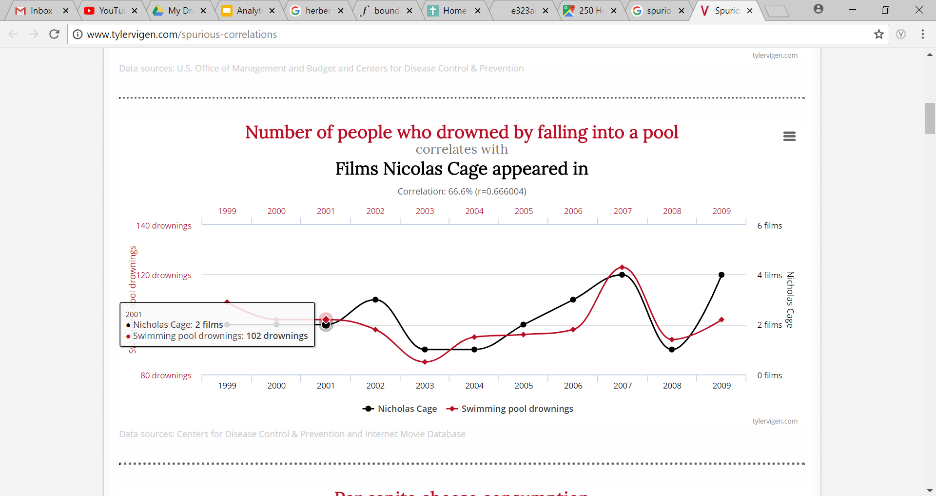
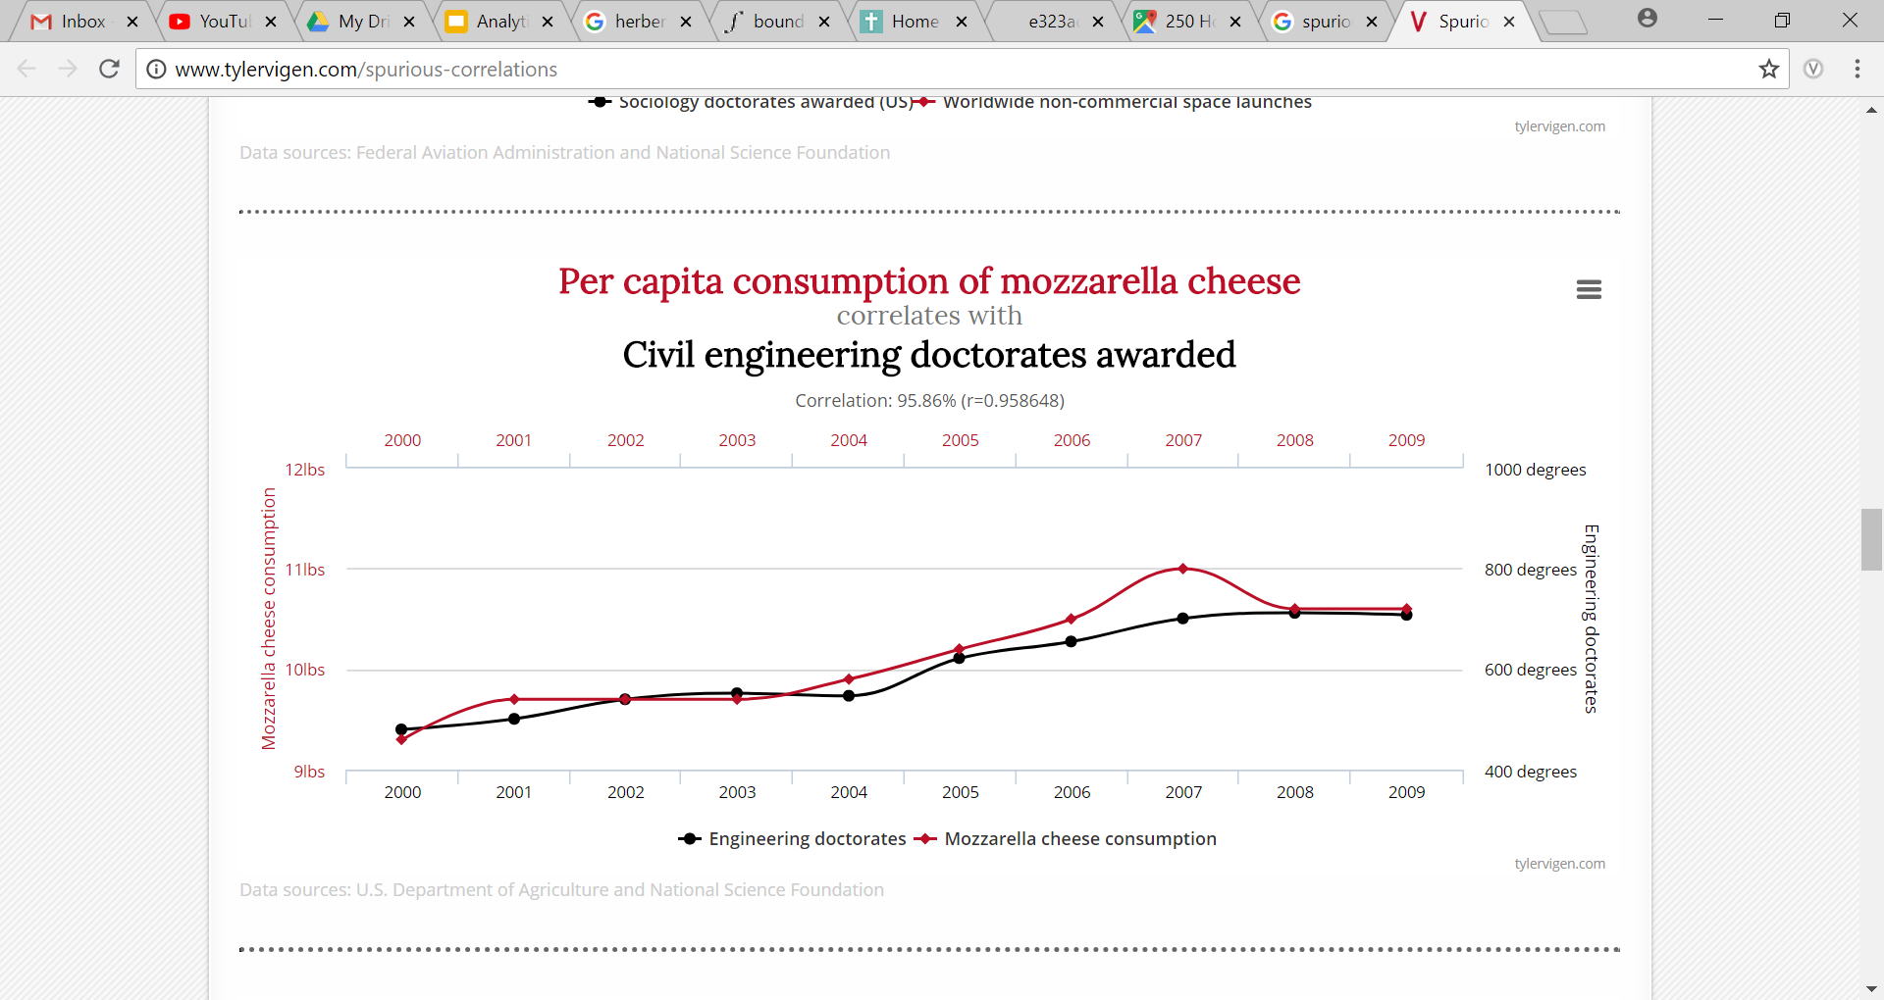
Regression vs Causation
The most important assumption of regression is the relationship between variables you specified is correct, i.e., cost per discharge depends on # beds (and not the other way round)

Slide 32
Regression vs Correlation
Correlation
Strength of relationship between two or more variables
Symmetric relationships between variables, i.e., both are random and correlation of (x1, x2) = correlation (x2, x1)
Regression
Asymmetric relationship: dependent variable is random (stochastic), independent variable is given (no stochastic)
For example, cost per discharge varies for a given # beds
Regression (x1, x2) ≠ Regression (x2, x1)

Slide 33
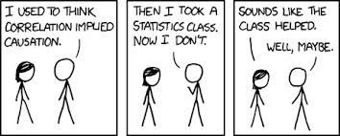
Regression vs Causation vs Correlation

Slide 34
Regression Terminology
Dependent variable (DV) - Alternative names
Explained variable
Predictand
Regressand
Response
Endogenous
Independent variable (IV) - Alternative names
Explanatory variable
Independent variable
Predictor
Control variable
Exogenous
Features

Slide 35
Regression – Functional forms and assumptions
y=a + b x + e, a= intercept, b= coefficient of x, e= error term
There are four important assumptions for a linear regression model
Linearity of relationship between (x,y)
Error terms have equal variance, i.e., Var [e(i)]=Var (e(j)) for all i,j
Errors terms are uncorrelated, i.e., CoVar [e(i), e(j)]= 0 for all i ≠ j
Error terms follow normal distribution e(i)~N[0, Var(e(i))]
What would happen when you relax these assumptions?
How would you make your linear regression model work when one or more of these assumptions do not hold true?

Slide 36
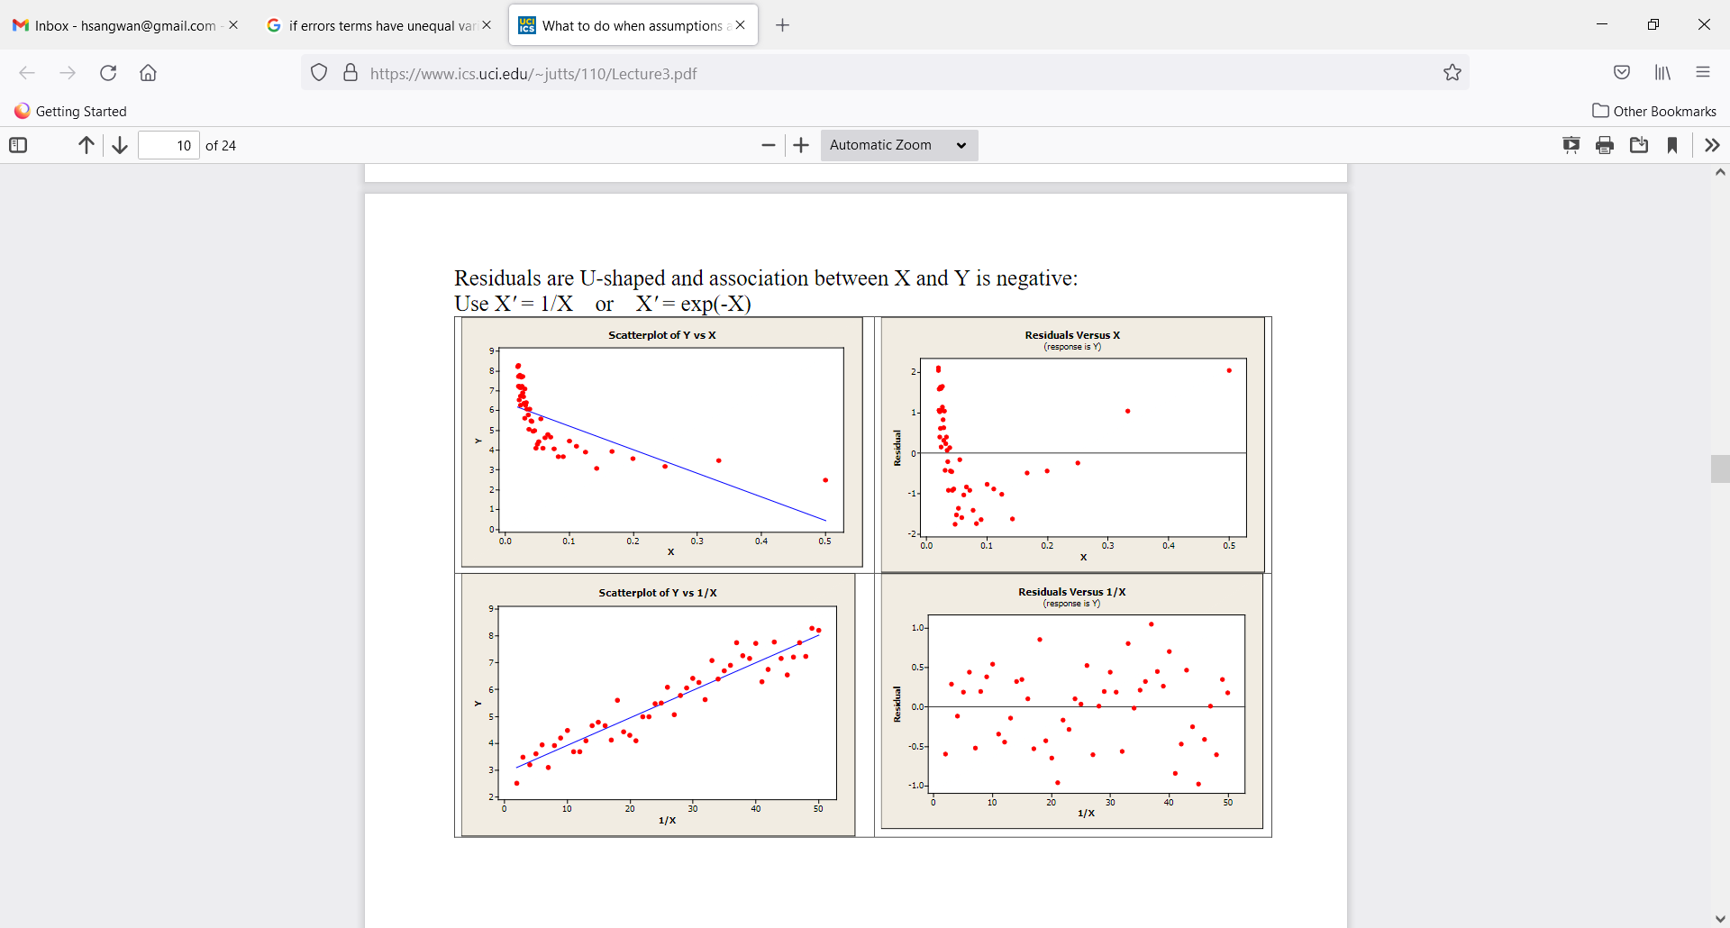
Assumption violated – Linearity of relationship between (x,y)
Transform X, i.e., X’=f(X) to make the relationship linear

Slide 37
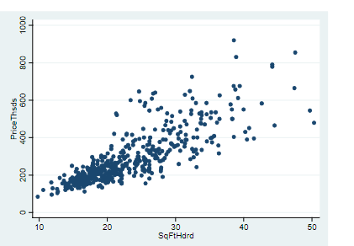
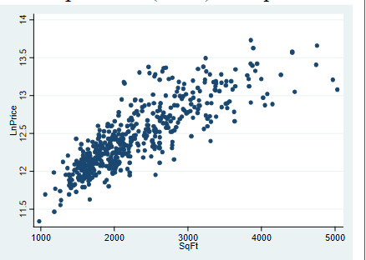
Assumption violated – Error terms have equal variance
Transform Y, i.e., Y’=f(Y) to make variance equal (or try to make it as equal as possible)

Slide 38
Regression – Interpretation of Coefficient and Error Terms
Error terms in y=a + b x + e, where e= error term
Omitted variables: e is a substitute for all OTHER variables which can affect DV but not included in the model
Unavailability of data on some variables leads us to treat them all under e
Intrinsic randomness: There are things which cannot be explained, not matter how hard you try!
We want to build a relationship which is “parsimonious”, i.e., as simple as possible
‘e’ also accounts for “wrong” functional form of model
Coefficient ‘b’: Average change in y for a given change in x
Interpretation of coefficient of dummy variables

Slide 39
Regression Estimation – Challenges
Multicollinearity
When X’s (features, IVs) are correlated, it is difficult to understand the unique impact of each variable on y.
Example: Effect of Age and Height on IQ. Age and Height are positively correlated
Unbiasedness of parameters
In repeated samples (s=1,2,3,4,5,6…..1000….), what would be the average (across samples) of parameters? Is the average be equal to / close to the true parameter which was hypothesized?

Slide 40
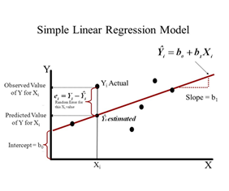
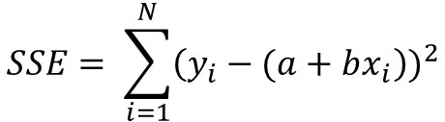


Regression Estimation – Closed form solution
Closed form solution
y=a + b x + e, e= error term
Minimize squared distance (error) between observed and predicted Y, the DV
SSE: Sum of Square of Errors: Measure of variance in y which cannot be explained by x
$$SSE= \sum_{i=1}^{N}{{\left(y_{i}−(a+bx_{i}\right))}^{2}}$$
$$b=\frac{cov(y,x)}{var(x)}=\frac{\sum_{i=1}^{N}{(x_{i}−\overline{x})(y_{i}−\overline{y})}}{\sum_{i=1}^{N}{{(x_{i}−\overline{x})}^{2}}}$$
b$={\left(X^{′}X\right)}^{−1}X^{′}y$

Slide 41
Regression Estimation – ML algorithm (Gradient Descent, GDD)
An ML algorithm for linear regression has the following two objectives
“Learn” the relationship between (x,y), i.e., make (a + b x) or h(ϑ) as close to y as possible
“Predict” y based on the “learned” relationship and new values of x’s
In other words, we make the algorithm “learn” the relationship between (x,y) so it can make predictions about y for new values of x’s

Slide 42
Regression using ML algorithm – Key terminology
Model y=h(ϑ)=a₀+b₂x₁+b₂x₂+𝜖 is called “hypothesis”, i.e., we are hypothesizing how (x,y) are related, i.e., in this case linear relationship between (x,y)
ϑ’s are model parameters. And it is a (k x 1) vector, where k= number of parameters
x’s are features. x is a (k x n) matrix where n= number of observations, x₀=1
Training sample: the sample we use to “train” our ML algorithm
Test sample: the sample we use to “test” our “trained” algorithm!
n₀= training sample, n₁= test sample; n₀ + n₁ = n = total sample size

Slide 43
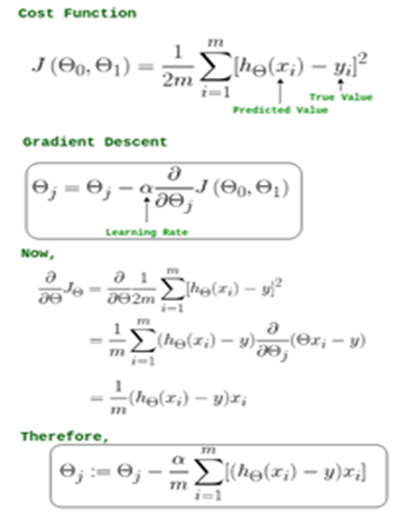
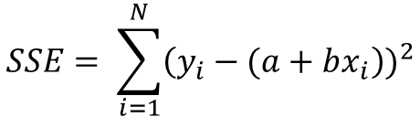

Regression Estimation – Closed form vs ML algorithm
ML algorithm
Closed form solution
$$SSE= \sum_{i=1}^{N}{{\left(y_{i}−(a+bx_{i}\right))}^{2}}$$
$$b=\frac{cov(y,x)}{var(x)}=\frac{\sum_{i=1}^{N}{(x_{i}−\overline{x})(y_{i}−\overline{y})}}{\sum_{i=1}^{N}{{(x_{i}−\overline{x})}^{2}}}$$

Slide 44
Questions – Regression
Suppose you have data on n=800 individuals on wages, education, experience and gender. In addition, you have information on individual’s marijuana use (coded as 0= No to marijuana use, 1= Yes to marijuana use)
How would you write a regression equation which allow you to estimate effect of marijuana on wages?
How do you test if marijuana usage has different effects on wages for men vs women?

Slide 45
Questions – Regression
Suppose you are an investment analyst at a boutique firm in downtown Toronto. One of your clients loves investing in gold and thinks gold provides the best hedging against inflation. The client reached out to you for advice and provided you with the following data
Is your client’s belief correct, i.e., gold being the best hedge against inflation?

Slide 46
Questions – Regression
Year | Gold Price (Index) | TSE (Index) | Consumer Price Index (Inflation)
2003 | 148.0 | 53.7 | 60.6
2004 | 193.4 | 53.7 | 65.2
2005 | 307.6 | 58.3 | 72.6
2006 | 612.5 | 68.1 | 82.4
2007 | 459.6 | 74.0 | 90.9
2008 | 376.0 | 68.9 | 96.5
2009 | 423.8 | 92.6 | 99.6
2010 | 360.3 | 92.5 | 103.9
2011 | 317.3 | 108.9 | 107.6
2012 | 376.9 | 136.0 | 109.6
2013 | 446.5 | 161.7 | 113.6
2014 | 436.9 | 149.9 | 118.3
2015 | 381.3 | 180.0 | 124.0
2016 | 384.1 | 183.5 | 130.7
2017 | 362.0 | 206.3 | 136.2

Slide 47
Regression – Housing Data
Each record in the database describes a Boston suburb or town. The data was drawn from the Boston Standard Metropolitan Statistical Area (SMSA) in 1970. The attributes are defined as follows (taken from the UCI Machine Learning Repository):
Key quesiton: How can we predict the MEDV (Median value of owner-occupied homes in $1000s) using all or some of the thirteen predictors or IVs? (Data: HousingData.txt and the code file)
CRIM per capita crime rate by town
ZN proportion of residential land zoned for lots over 25,000 sq.ft.
INDUS proportion of non-retail business acres per town
CHAS Charles River dummy variable (= 1 if tract bounds river; 0 o/w)
NOX nitric oxides concentration (parts per 10 million)
RM average number of rooms per dwelling
AGE proportion of owner-occupied units built prior to 1940
DIS weighted distances to five Boston employment centres
RAD index of accessibility to radial highways
TAX full-value property-tax rate per $10,000
PTRATIO pupil-teacher ratio by town
B 1000(Bk -0.63)^2 where Bk is the proportion of blacks by town
LSTAT % lower status of the population
MEDV Median value of owner-occupied homes in $1000's

Slide 48
Regression – Key Takeaways
Regression analysis is statistical dependence of 1 variable (DV) on other variables (IVs)
Statistical dependence ≠ Dependence in reality
Estimate / predict mean value (not the actual value) of DV on the basis of known / fixed value of IVs
For linear regression, closed form and ML algorithm give the same values for estimated parameters

Slide 49
Multivariate Linear Regression

Slide 50
Need for Multivariate Regression
Suppose we have data from five different samples and want to test the following hypothesis H₀: µ_{i}=µ, i=1 to 5
Univariate way: when H₀ is TRUE, there is a 95% probability of getting “non-significant” results
Given all five samples are considered independently → If five independent tests are carried out under these conditions
probability of getting “non-significant” results overall = (0.95)⁵ = 77%
probability of at least 1 “significant” result = 1-0.77 = 23%
Nulls are H₀ is TRUE → our test is rejecting it with probability 23%

Slide 51
Multivariate Regression
It is completely possible
Insignificant univariate tests but significant multivariate test
Test 1: No difference in y (attitude on tax policy) by gender (male, female)
Test 2: No difference in y by political affiliation
Collectively: Significant difference in y when (gender, political affiliation) considered together
This can occur because of the accumulation of the evidence from the individual variables in the overall test
A few significant univariate tests but insignificant multivariate test
Test 1: Significant difference in y (attitude on tax policy) by gender (male, female)
Test 2: No difference in y by political affiliation
Collectively: No difference in y when (gender, political affiliation) considered together
It can occur when evidence of difference by some variables is swamped by the evidence of no difference provided by other variables

Slide 52
Example – Univariate and Multivariate Tests
“As an example of the use of the univariate and multivariate tests that have been described for two samples, consider again the female sparrow data. Here, there is a question about whether there are any differences between survivors and non-survivors with respect to the mean values of five morphological characters.”

Slide 53
Data – Univariate and Multivariate Tests
Survivorship Total_length Alar_extent L_beak_head L_humerous L_keel_sternum
S 156 245 31.6 18.5 20.5
S 154 240 30.4 17.9 19.6
S 153 240 31 18.4 20.6
S 153 236 30.9 17.7 20.2
S 155 243 31.5 18.6 20.3
S 163 247 32 19 20.9
S 157 238 30.9 18.4 20.2
S 155 239 32.8 18.6 21.2
S 164 248 32.7 19.1 21.1
S 158 238 31 18.8 22
S 158 240 31.3 18.6 22
S 160 244 31.1 18.6 20.5
S 161 246 32.3 19.3 21.8
S 157 245 32 19.1 20
S 157 235 31.5 18.1 19.8
S 156 237 30.9 18 20.3
S 158 244 31.4 18.5 21.6
S 153 238 30.5 18.2 20.9
S 155 236 30.3 18.5 20.1
S 163 246 32.5 18.6 21.9
S 159 236 31.5 18 21.5
NS 155 240 31.4 18 20.7
NS 156 240 31.5 18.2 20.6
NS 160 242 32.6 18.8 21.7
NS 152 232 30.3 17.2 19.8
NS 160 250 31.7 18.8 22.5
NS 155 237 31 18.5 20
NS 157 245 32.2 19.5 21.4
NS 165 245 33.1 19.8 22.7
NS 153 231 30.1 17.3 19.8
NS 162 239 30.3 18 23.1
NS 162 243 31.6 18.8 21.3
NS 159 245 31.8 18.5 21.7
NS 159 247 30.9 18.1 19
NS 155 243 30.9 18.5 21.3
NS 162 252 31.9 19.1 22.2
NS 152 230 30.4 17.3 18.6
NS 159 242 30.8 18.2 20.5
NS 155 238 31.2 17.9 19.3
NS 163 249 33.4 19.5 22.8
NS 163 242 31 18.1 20.7
NS 156 237 31.7 18.2 20.3
NS 159 238 31.5 18.4 20.3
NS 161 245 32.1 19.1 20.8
NS 155 235 30.7 17.7 19.6
NS 162 247 31.9 19.1 20.4
NS 153 237 30.6 18.6 20.4
NS 162 245 32.5 18.5 21.1
NS 164 248 32.3 18.8 20.9

Slide 54
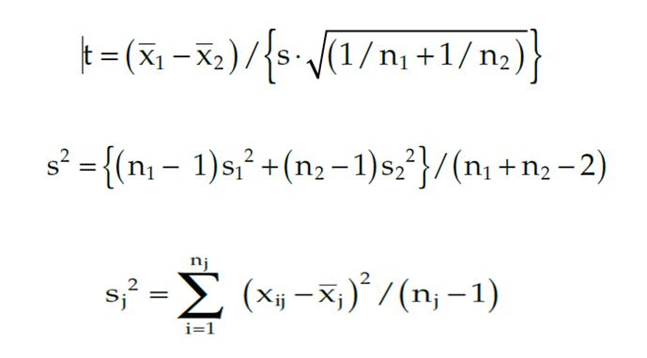
Univariate tests for means
Comparison of means of overall length for survivors and non-survivors, T-test
Fairly robust to assumptions of normality, equal variance, and same sample size

Slide 55
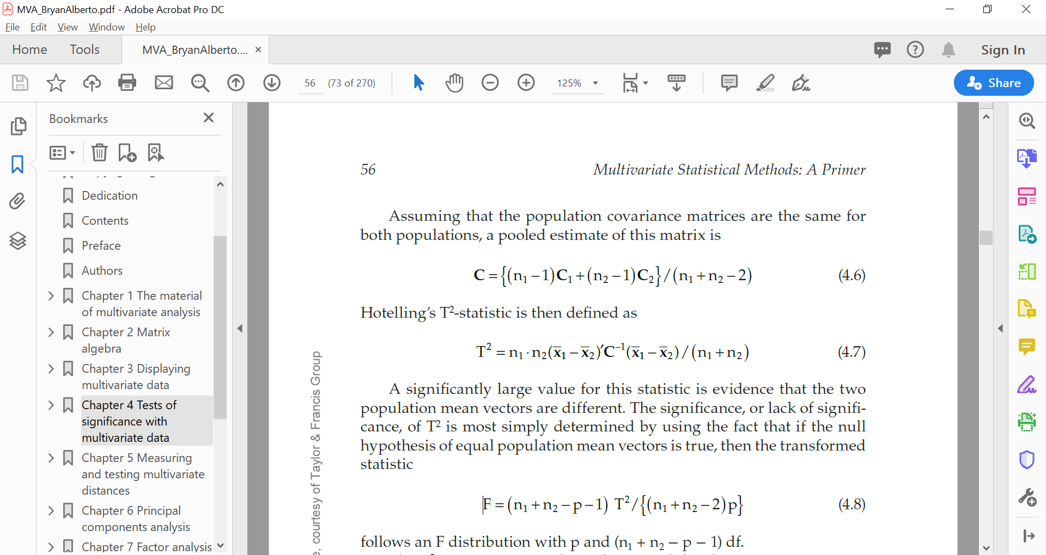
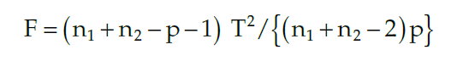
Multivariate tests for means
Do all 5 variables considered together suggest a difference between survivors and non survivors? Hotelling T² test
C1, C2= sample covariance matrices. F~ F distribution (p=5, n1+n2-p-1=43)
A significantly large value for T² is an evidence that the two population mean vectors are different

Slide 56
R code – Univariate test
# Testing mean values for Bumpus' female sparrows
# t-tests, one by one. Survivors vs. Non survivors
sparrows <- read.csv("Bumpus_sparrows.csv",header=TRUE)
with(data=sparrows,t.test(Total_length[Survivorship=="S"], Total_length[Survivorship=="NS"],var.equal=TRUE))
with(data=sparrows,t.test(Alar_extent[Survivorship=="S"], Alar_extent[Survivorship=="NS"],var.equal=TRUE))
with(data=sparrows,t.test(L_beak_head[Survivorship=="S"], L_beak_head[Survivorship=="NS"],var.equal=TRUE))
with(data=sparrows,t.test(L_humerous[Survivorship=="S"], L_humerous[Survivorship=="NS"],var.equal=TRUE))
with(data=sparrows,t.test(L_keel_sternum[Survivorship=="S"], L_keel_sternum[Survivorship=="NS"],var.equal=TRUE))
# End of the script

Slide 57
R code – Multivariate test
# Testing mean values for Bumpus' female sparrows
# t-tests, one by one. Survivors vs. Non survivors
# Hotelling's T2 test. Comparing multivariate means # between survivor and non-survivor sparrows
# Uses libraries "Hotelling“. # Before running library(Hotelling) make sure you have installed the package
sparrows <- read.csv("Bumpus_sparrows.csv",header=TRUE)
library(Hotelling)
# Hotelling's test is generated through a formula. The result is a list
t2testsparr <- hotelling.test(Total_length + Alar_extent + L_beak_head + L_humerous + L_keel_sternum ~ Survivorship, data=sparrows)
# T2 statistic is located in the first element of the list "stat"
cat("T2 statistic =",t2testsparr$stat[[1]],"\n")
# Output of the function hotelling.test is given
t2testsparr
detach(sparrows)
# End of the script

Slide 58
Recommended Readings
Applied Multivariate Analytics. Retrieved from https://towardsdatascience.com/applied-multivariate-regression-faef8ddbf807
Multivariate ANOVA (MANOVA) Benefits and When to Use It: Retrieved from https://statisticsbyjim.com/anova/multivariate-anova-manova-benefits-use/

Slide 59
Next Session

